Slide 1
What to remember from Chap 13
(Logical architecture)

Slide 2
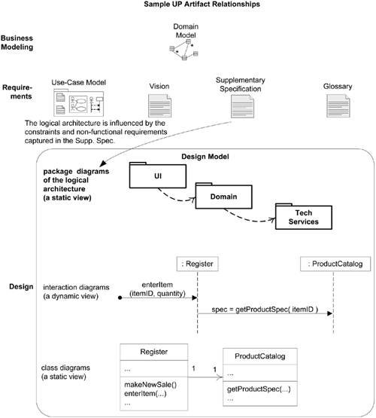

Slide 3
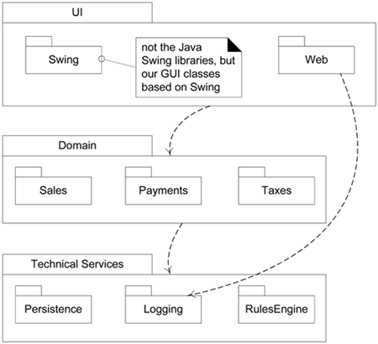
Example of logical architecture using a UML package diagram.

Slide 4
Logical Architecture
Logical architecture: the large-scale organization of software classes into packages, subsystems, and layers.
  “Logical” because no decisions about how these elements are deployed across different operating system processes or across physical computers in a network
.

Slide 5
Layers
A layer is a very coarse-grained grouping of classes, packages, or subsystems that has cohesive responsibility for a major aspect of the system.
  Layers are organized such that "higher" layers (such as the UI layer) call upon services of "lower" layers, but not normally vice versa. Typically layers in an OO system include:

Slide 6
  User Interface.
  Application Logic and Domain Objects software objects representing domain concepts (for example, a software class Sale) that fulfill application requirements, such as calculating a sale total.
  Technical Services general purpose objects and subsystems that provide supporting technical services, such as interfacing with a database or error logging. These services are usually application-independent and reusable across several systems.

Slide 7
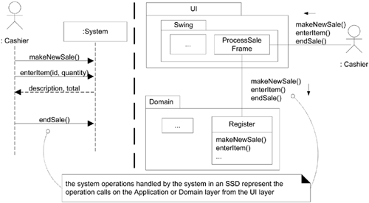
Connection between SSDs, System Operations and Layers
In a well-designed layered architecture that supports high cohesion and a separation of concerns, the UI layer objects will then forward the request from the UI layer onto the domain layer for handling.

Slide 8
On To Object Design
Chapter 14
Applying UML and Patterns
-Craig Larman

Slide 9
Designing Objects:
Static and dynamic modeling.
Two kinds of object models:
  Static models :
      Class diagrams / Package diagram / Deployment diagram
    Helps design definition of packages, class name, attributtes and method signature
  Dynamic models:
      Interaction Diagrams/ (Sequence / comunication). State machine diagrams/activity diagram
    Illustrate how objects collaborate via messages and methdos . They help design the logic and method bodies
WSEP 06

Slide 10
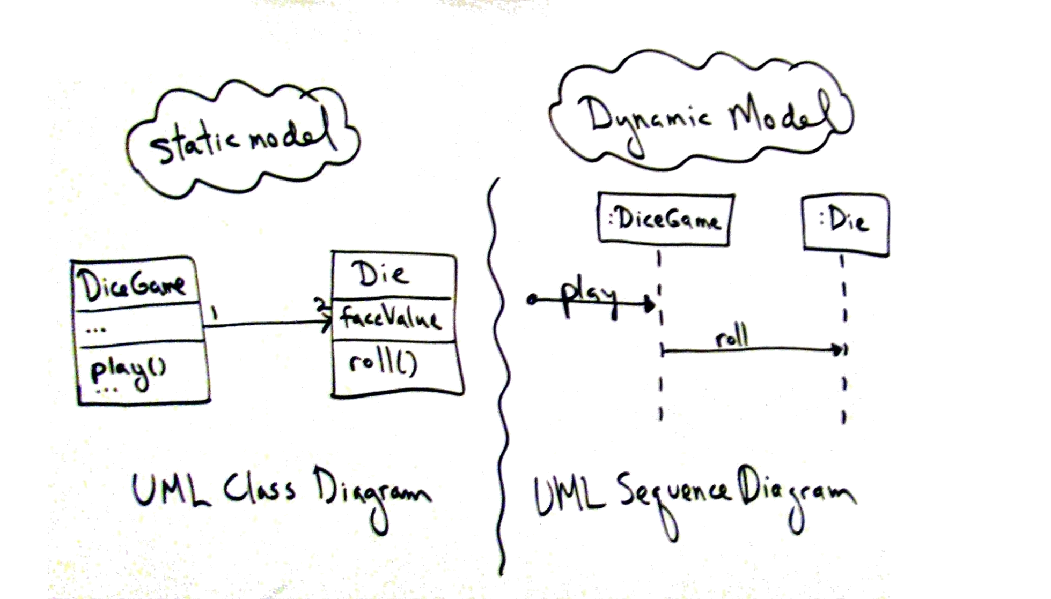
  Agile modeling practice
  Create Models in parallel!
  Modeling with others

Slide 11
On To Object Design
Chapter 15
Applying UML and Patterns
-Craig Larman

Slide 12
A First Look at interaction Diagrams
Illustrate how objects interacts with each other.
Emphasizes time ordering of messages.
Can model simple sequential flow, branching, iteration, …etc
Sequence Diagrams

Slide 13
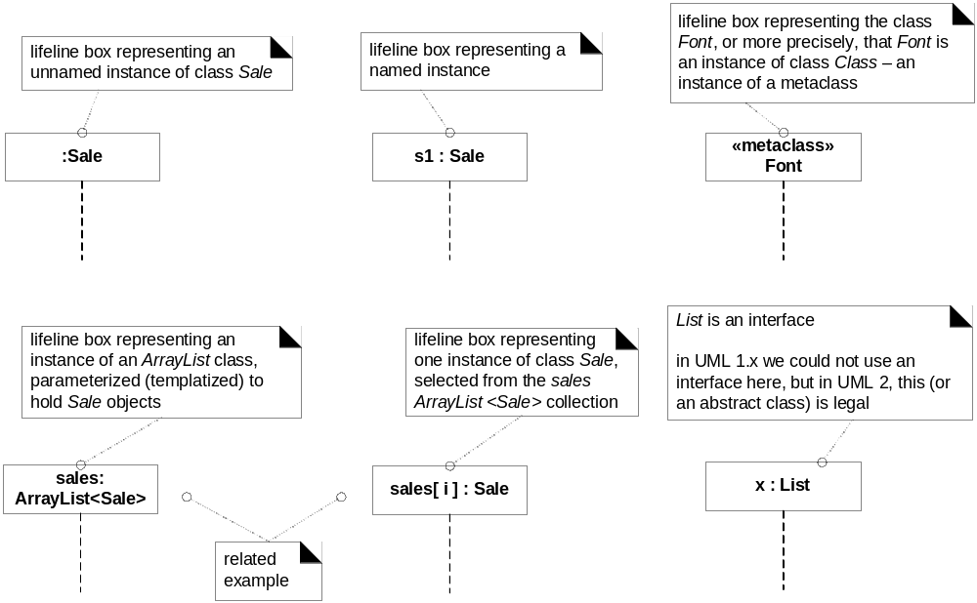
Fig. 15.5

Slide 14
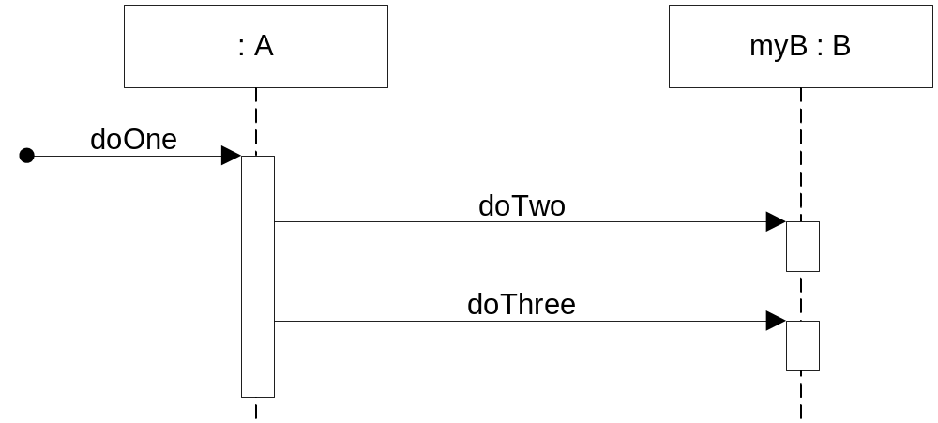
Fig. 15.1:sequence diagram

Slide 15
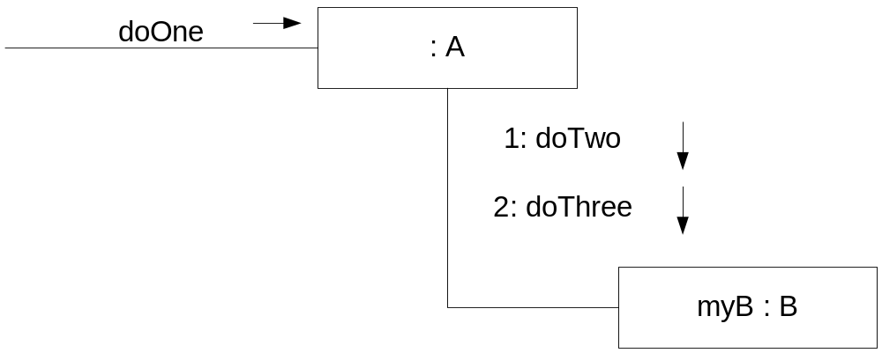
Fig. 15.2:communication diagram

Slide 16
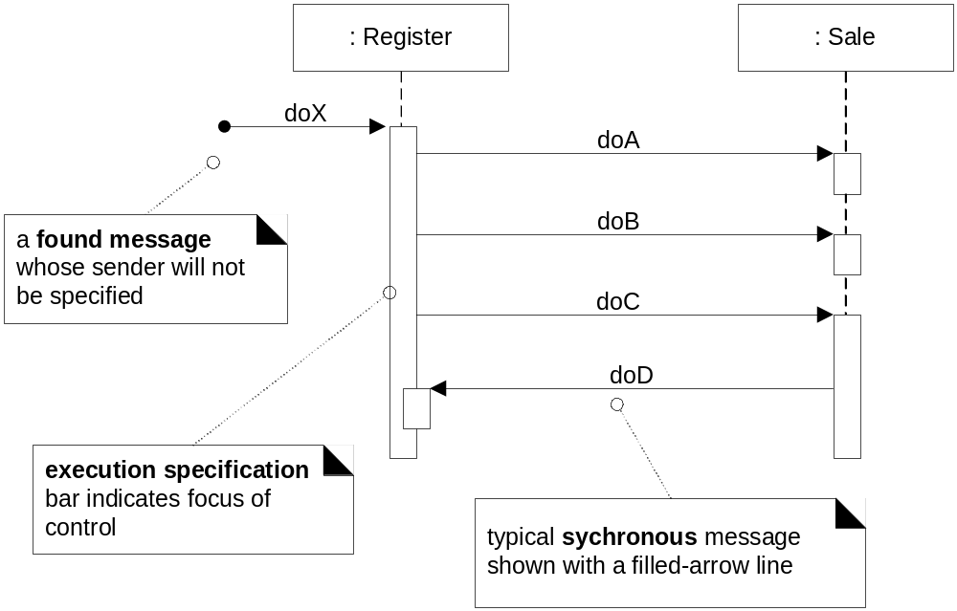
Sequence diagram notation
Figure 15.7

Slide 17
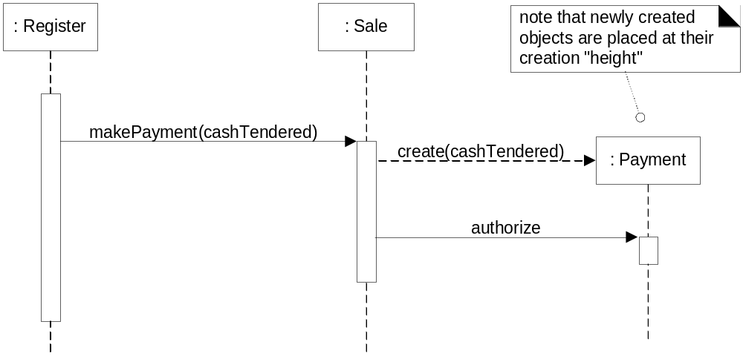
Creation of Instances
Figure 15.10

Slide 18
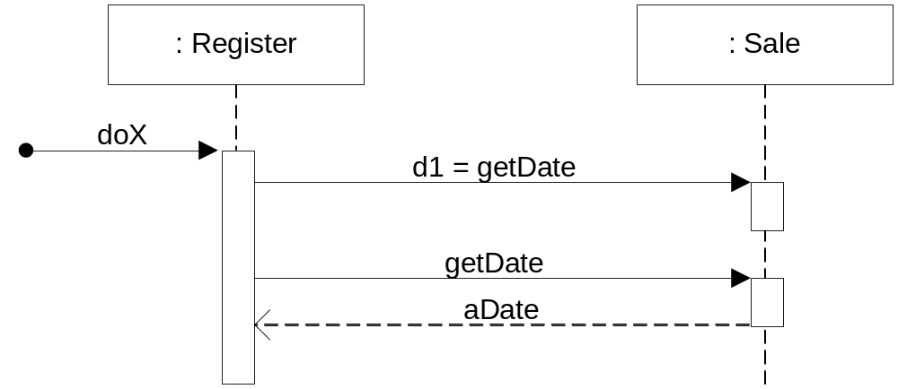
Fig. 15.8 : How to show a return result ?

Slide 19
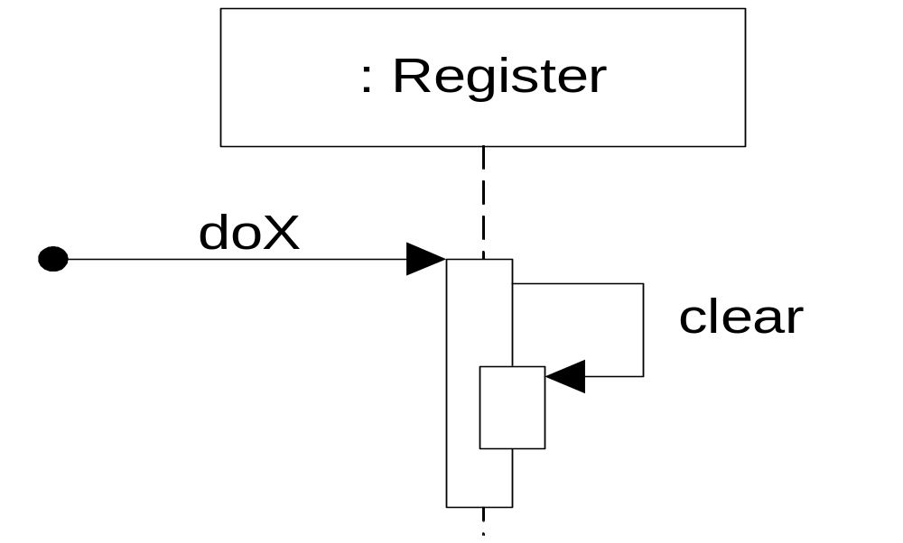
Fig. 15.9: Messages to “self”

Slide 20
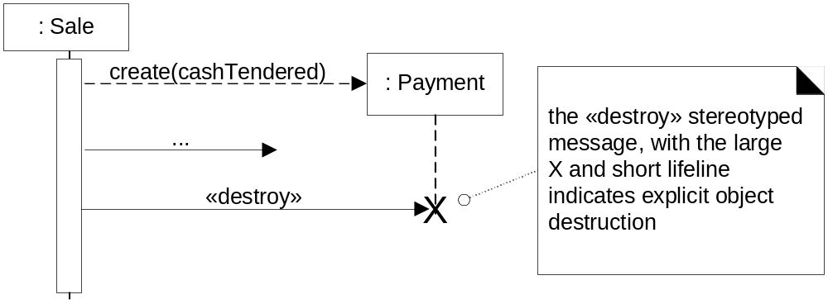
Fig. 15.11: Object destruction

Slide 21
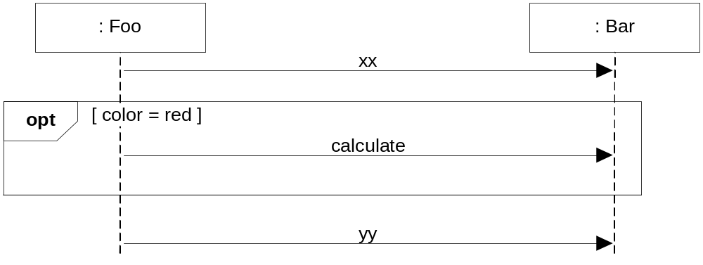
Conditional message : OPT frame is placed around one or more messages.
opt: Optional fragment that execute if guard is true
Figure 15.13

Slide 22
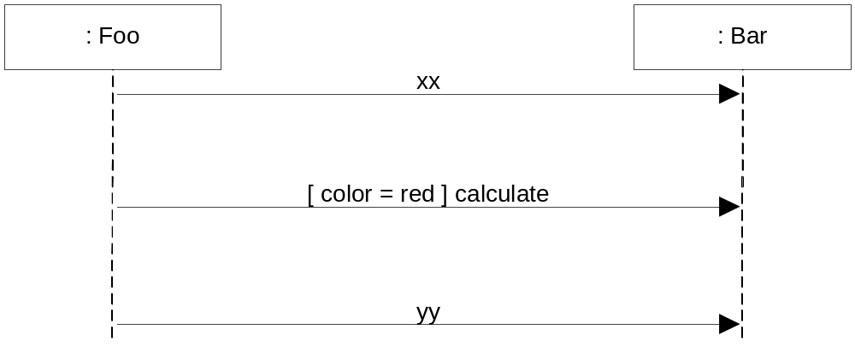
Conditional message : UML1.x notation
Figure 15.14
Which one do you prefer?

Slide 23
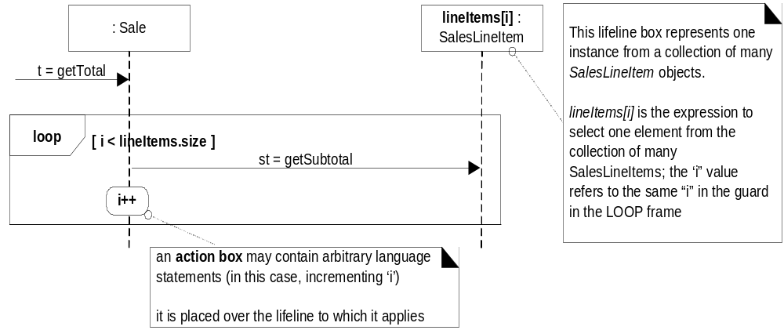
Loops (iteration over a collection) in sequence diagrams:
Figure 15.16

Slide 24
Public class Sale
{ private List<SalesLineItem> lineItems = new ArrayList<SalesLineItem>(); public Money getTotal()
{
Money total = new Money();
Money subtotal = null; for(SalesLineItem lineItem : lineItems)
{ subtotal = lineItem.getSubtotal(); total.add(subtotal);
} return total;
}
….//
}

Slide 25
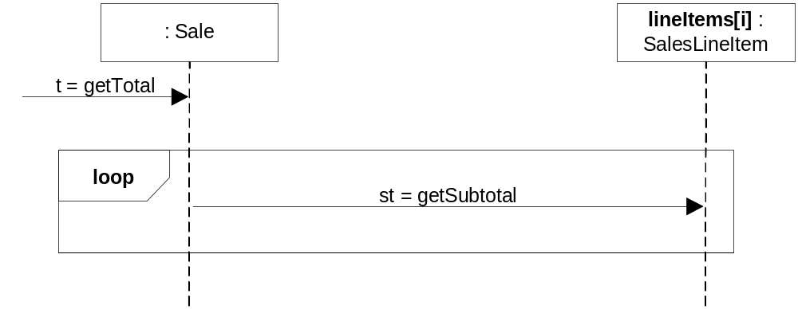
Loops (iteration over a collection) in sequence diagrams:
Figure 15.17
Which notation do you prefer?

Slide 26
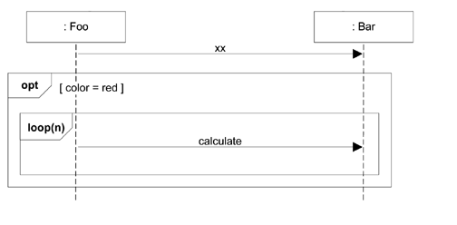
Nesting of frames

Slide 27
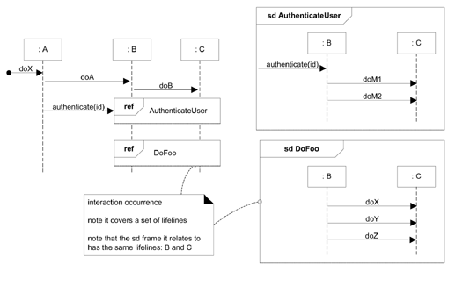
How relate Interaction diagram?

Slide 28
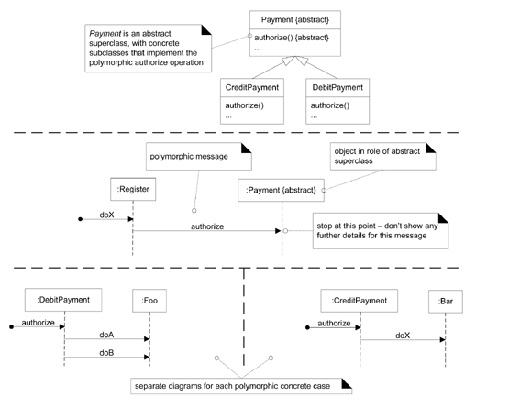
Polymorphism:
How is it shown in interaction diagrams?

Slide 29
Questions?

Slide 30
Project work for today
Finish operation contracts for “ register vikingShip”
Architecture Analysis
use case design of “register VikingShip”
That is : Open the black box “System” in the SSD from analysis and show how objects collaborate.
Add method names to the classes.

Slide 31
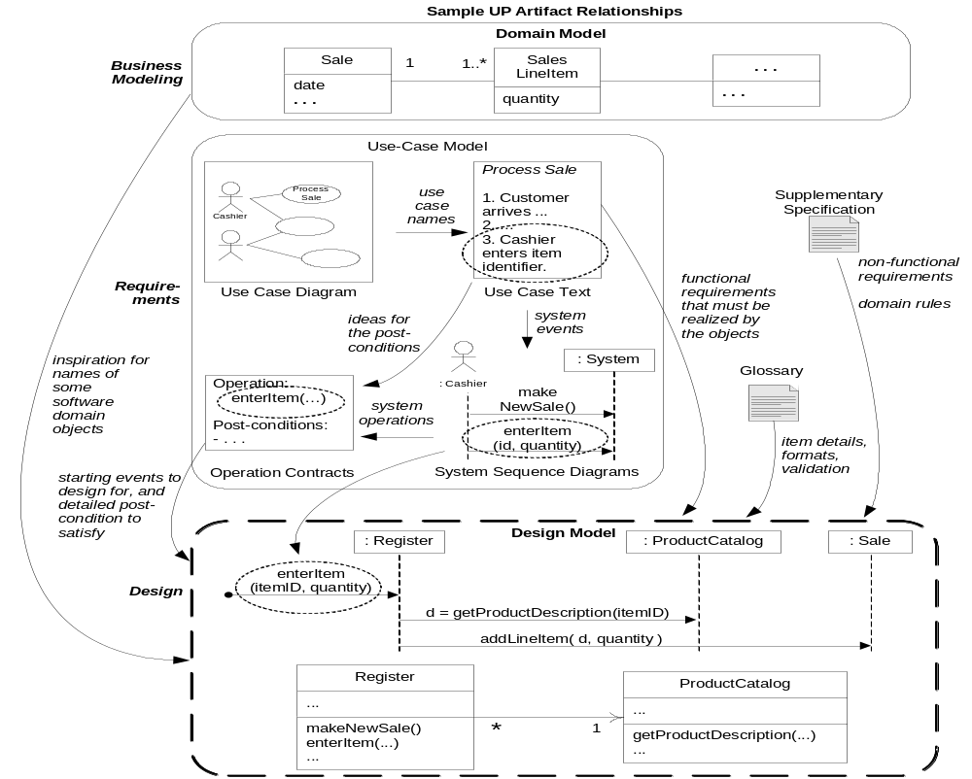
Fig. 17.1 UP artifacts influencing OO design

Slide 32
Introduction to Creator Pattern
Problem: Who should be responsible for creating a new instance of some class?
Solution: Assign class B the responsibility to create an instance of class A if one or more of these is true:
  B contains (compositely aggregates) A.
  B records A.
  B closely uses A.
  B has the initializing data for A that will be passed to A when it is created.

Slide 33
Introduction to Controller Pattern
Problem: What first object beyond the UI layer receives and coordinates (“controls”) a system operation?
Solution: Assign the responsibility to a class that represents
  the overall system, a “root” object, a device that the software is running within, or a major subsystem (a façade controller), or
  a use case scenario within which the system event occurs (use case or session controller).

Slide 34
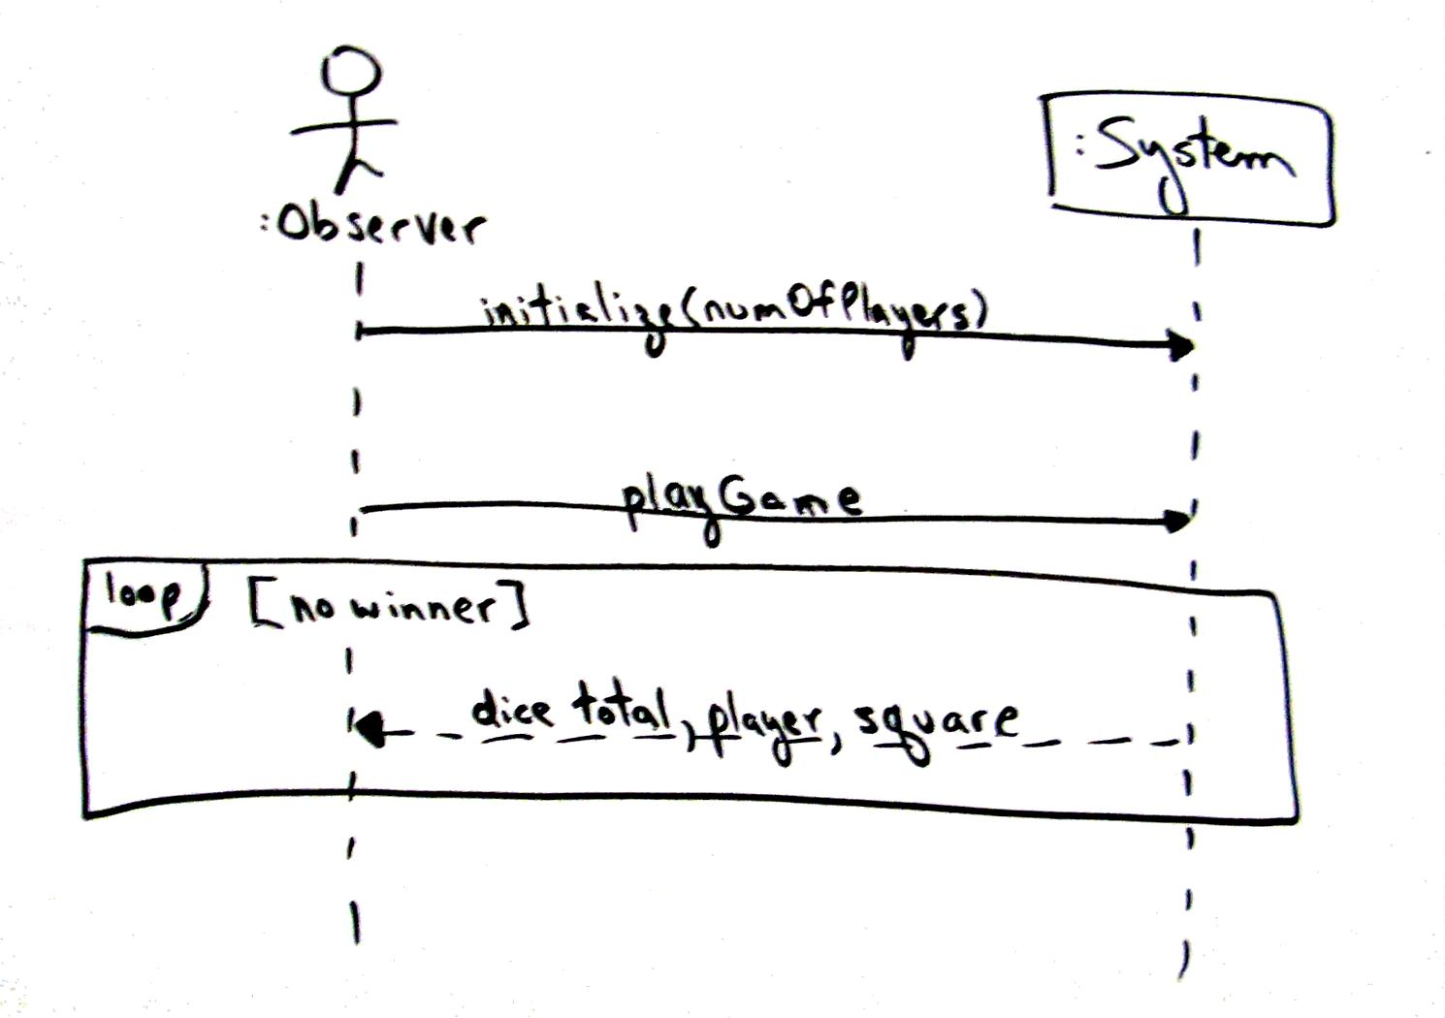

Fig. 17.8 System Sequence Diagram for Monopoly

Slide 35
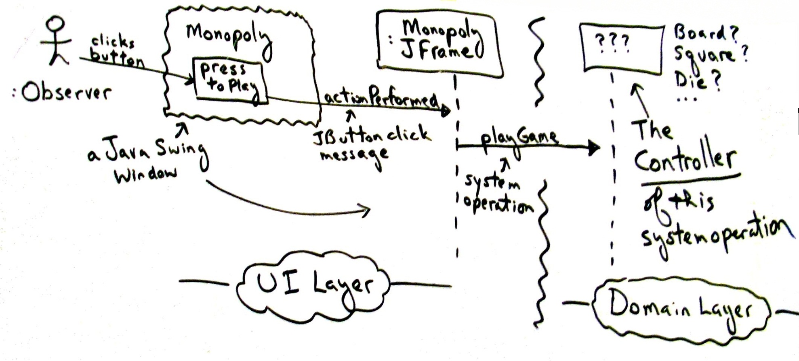
Fig. 17.9 Who is Controller for playGame?

